Slide 1
Fraudulant Transactions
File created on: 11/30/2023 2:29:25 AM

Slide 2
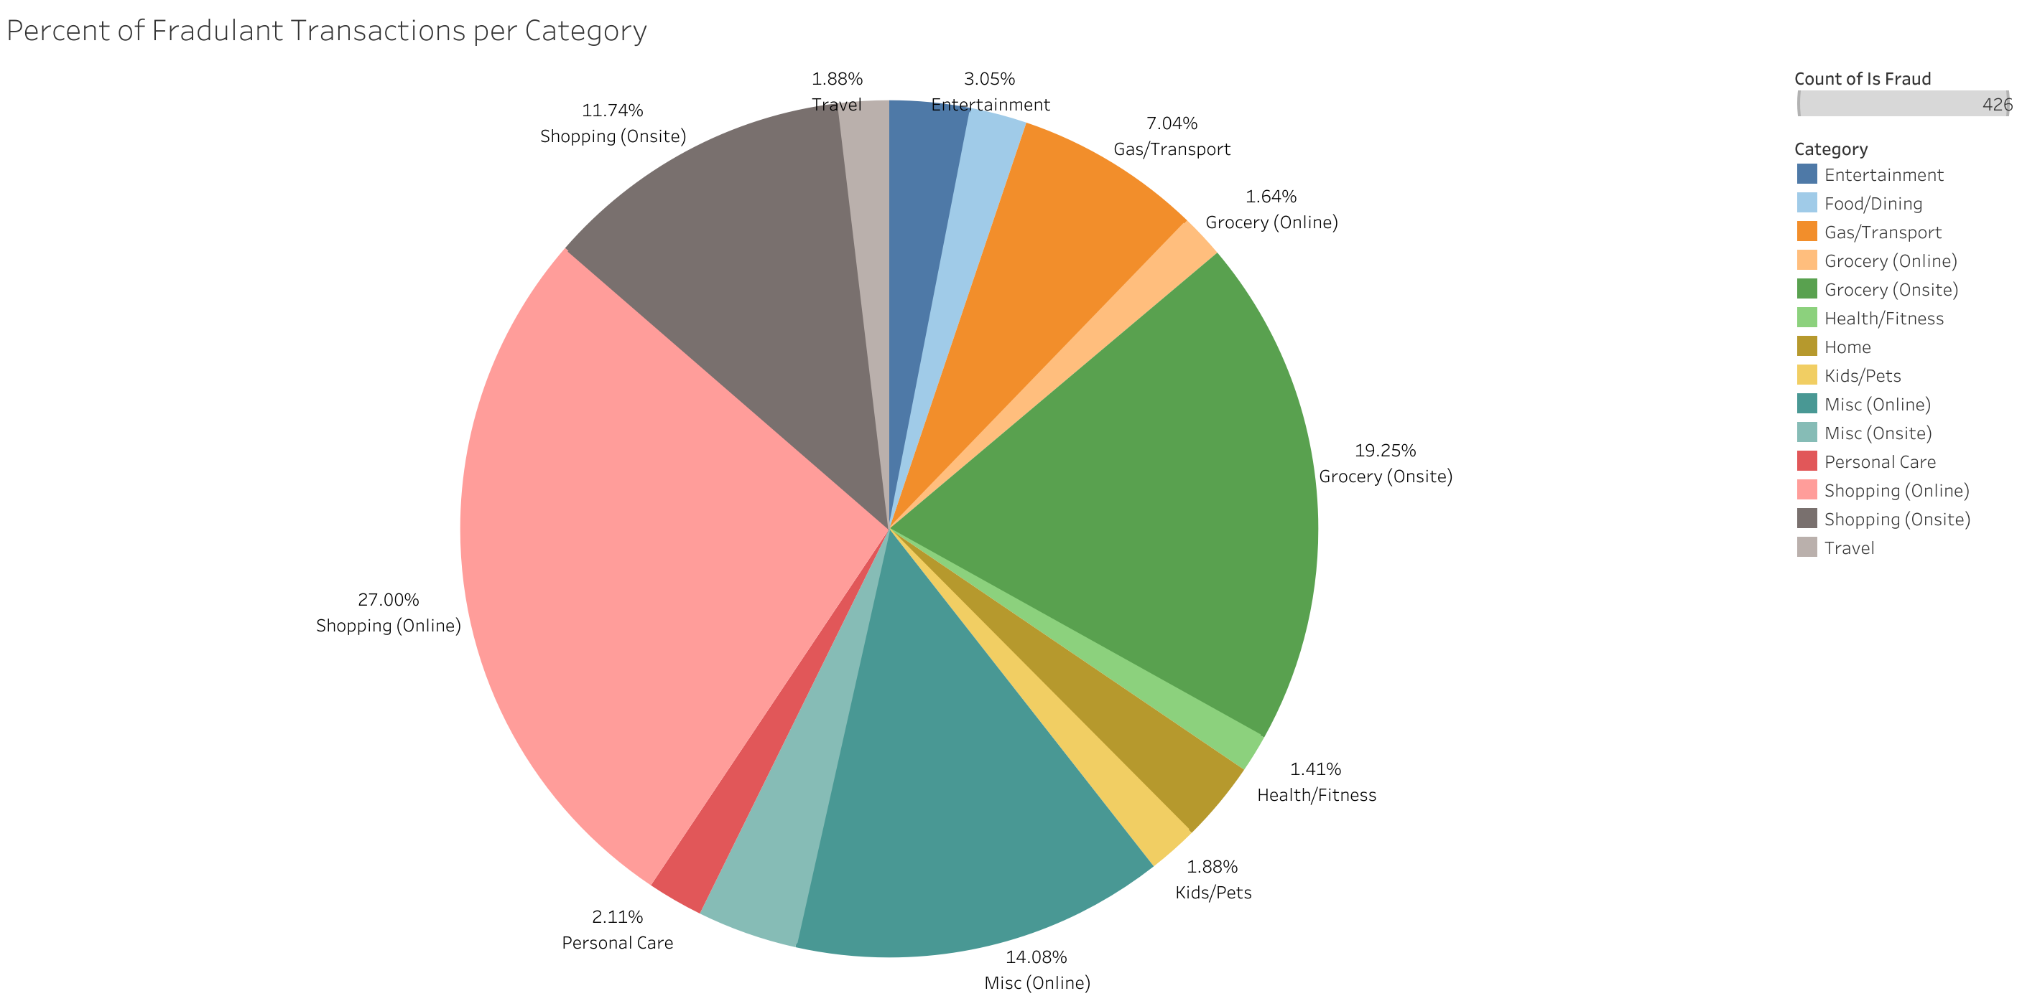

Slide 3
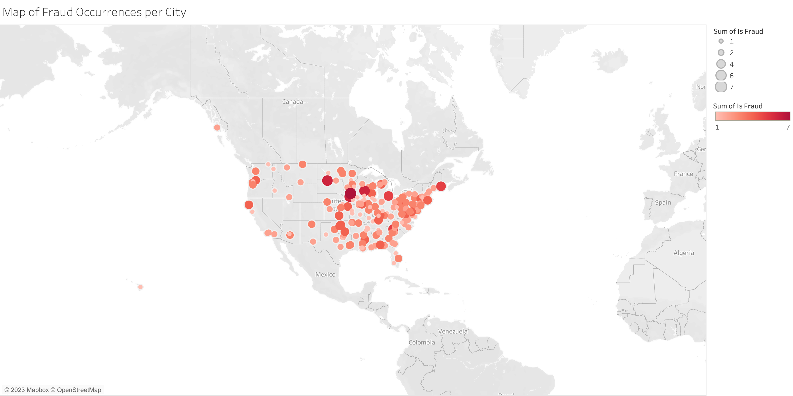

Slide 4
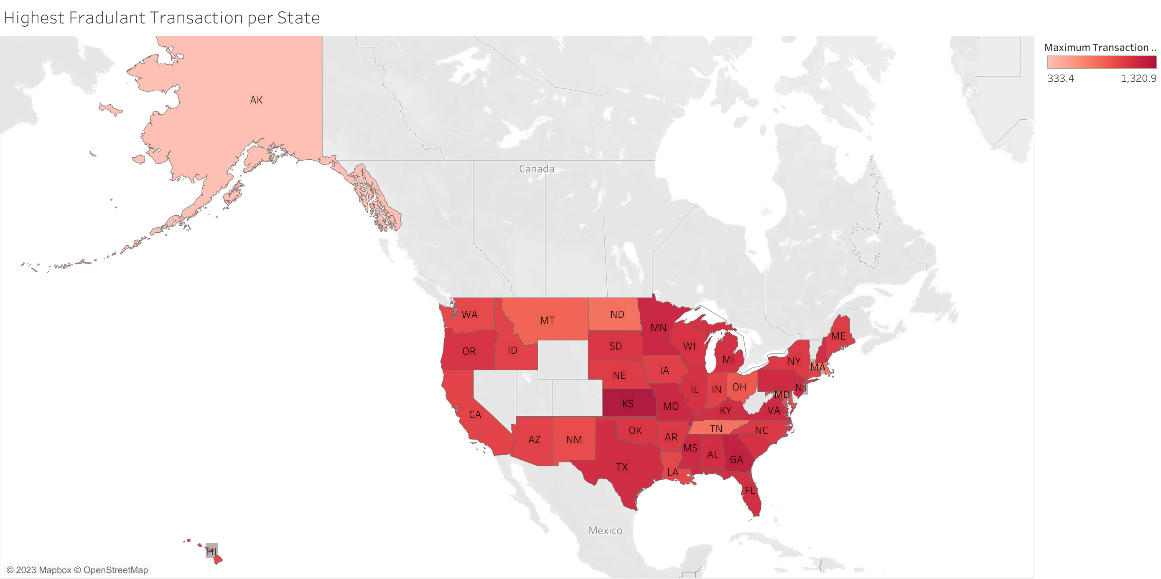

Slide 5
